Slide 1
MOTHERBOARD
Motherboard is the main component of the CPU.
Backbone of the Computer
It integrated all Hardware components into one system
Allows all parts of your computer to receive power and communicate with one another

Slide 2
COMPONENTS OF MOTHERBOARD
Expansion slots(PCI Express, PCI, AGP)
3 – pin case fan connectors
Back pane connectors
Heat sink
4–Pin (P4) power connector
Inductor
Capacitor
CPU Socket
Northbridge and Southbridge

Slide 3
Contd.
Memory slot
Floppy connection
ATA (IDE) disk drive primary connection
24-pin ATX power supply connector
Serial ATA connections
Coin cell battery (CMOS backup battery)
Serial port connector
USB headers and jumpers
Integrated circuit

Slide 4
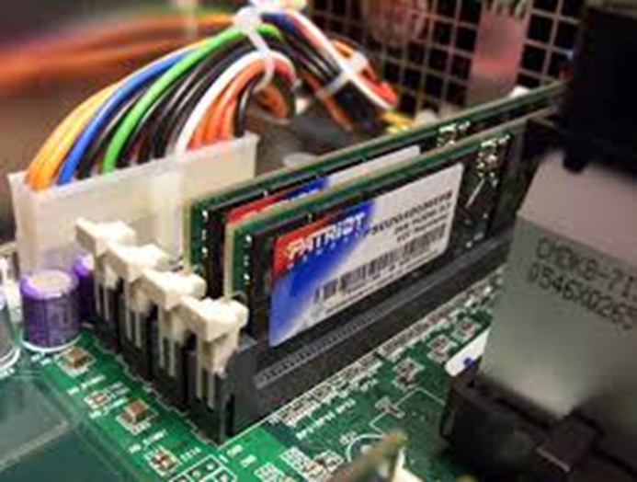
RAM(RANDOM ACCESS MEMORY)
Random Access Memory (RAM) is a hardware device that allows information to be stored and retrieved on a computer.

Slide 5
TYPES OF RAM
Static RAM: SRAM is random access memory that retains data bits in its memory as long as power is being supplied.
Dynamic RAM: Dynamic random-access memory is a type of random access semiconductor memory that stores each bit of data in a separate tiny capacitor within an integrated circuit.

Slide 6
TYPES OF RAM SLOTS
SIMM slot :
SIMM RAM had to be installed at an angle and pushed upright into place.
DIMM slot :
DIMM slots allow for straight-forward installation of memory modules.
RIMM slot :
The module slots for RIMMs were physically similar to DIMM slots and the modules were installed in the same way.

Slide 7
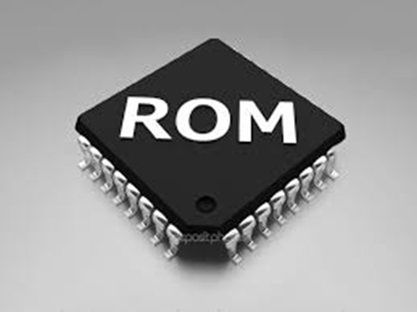
ROM(READ ONLY MEMORY)
Read-Only Memory is a storage medium that is used with computers and other electronic devices.

Slide 8
TYPES OF ROM
Masked ROM
PROM
EPROM
EEPROM
Flash ROM

